Slide 1
COMS E 6910 Midterm:
Gameful Direct Instruction (Parson’s Puzzle)
Sudhanshu Mohan
November 11, 2017

Slide 2
Agenda
Sprint 0
Sprint 1
Sprint 2

Slide 3
Sprint 0
Massive Github Branch Cleanup
master
block-ids
merge-upstream
parsons-points-julie
julie-parsons-points
julie-points
parsons
master
development
block-ids

Slide 4
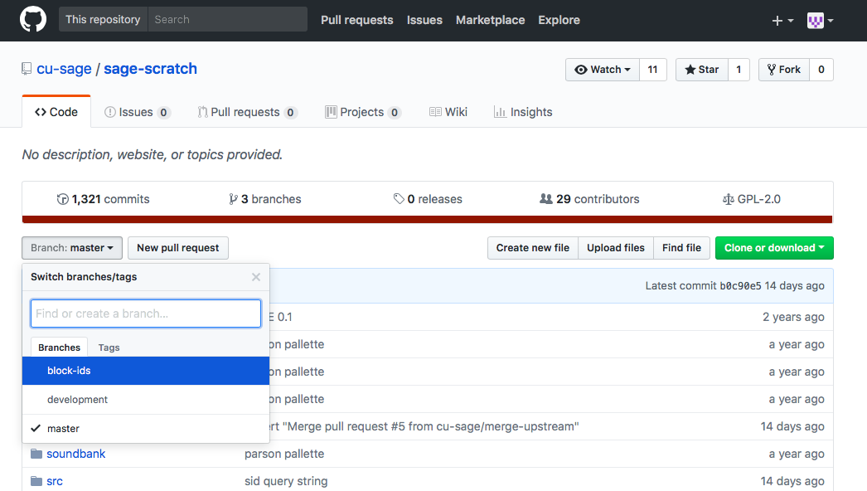
Sprint 0

Slide 5
Sprint 1
Student, Assessment, Mode & Game Type via Query String
Earlier when Scratch was launched, it used to ask the student to fill in Student ID and Assessment ID in a modal dialog
Ideally, Scratch should be able to recognise the student and assessment ID
The info is passed to the Flash via query strings
Scratch stores the identity of the user and any associated assessment, mode and game type in memory when the game is opened

Slide 6
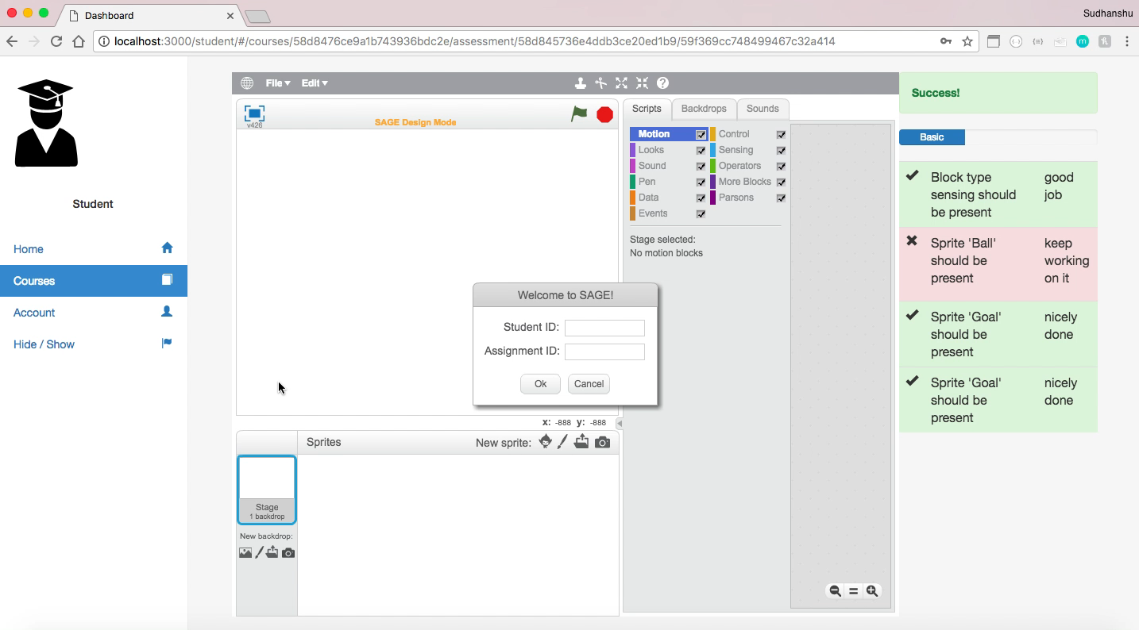
Sprint 1
Earlier

Slide 7
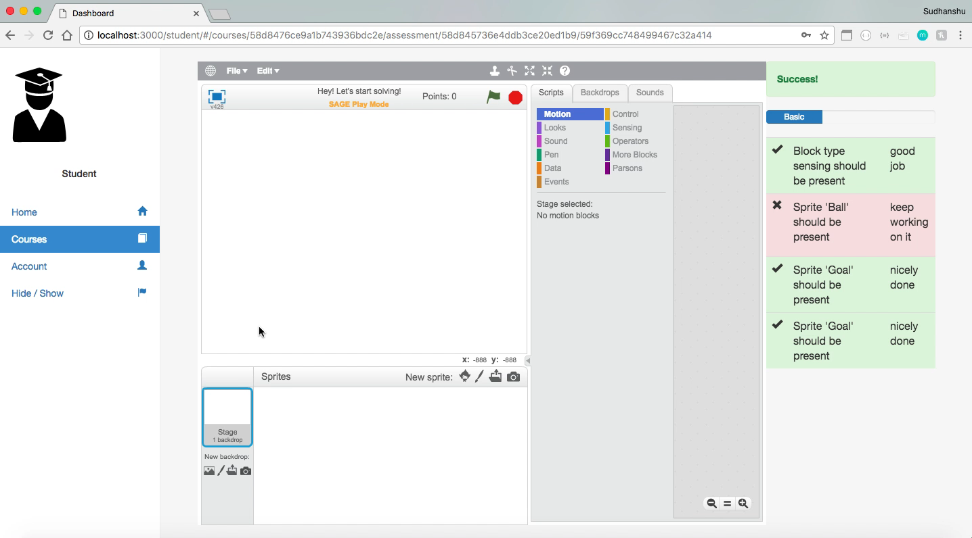
Sprint 1
Now

Slide 8
Sprint 2
Integrated Parson's Puzzles
When a Parson's Puzzle is loaded in Design mode, the puzzle solution should appear in the script pane
When a Parson's Puzzle is loaded in Play mode, the puzzle solution should not appear in the script pane.
When a Parson's Puzzle is loaded in any mode, the stage content should display.
When a Constructionist Video Game is loaded in any mode, all content should display.

Slide 9
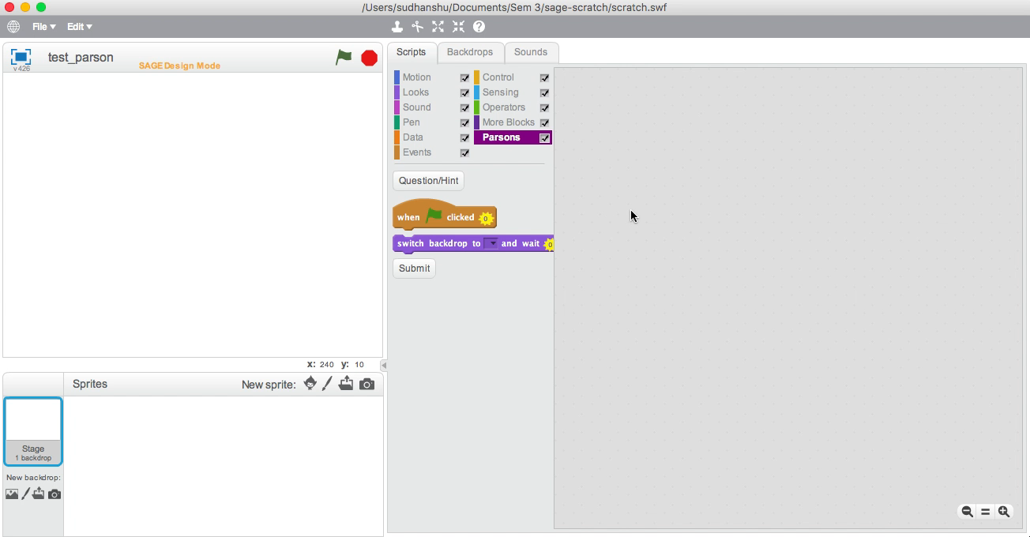
Sprint 2
Earlier

Slide 10
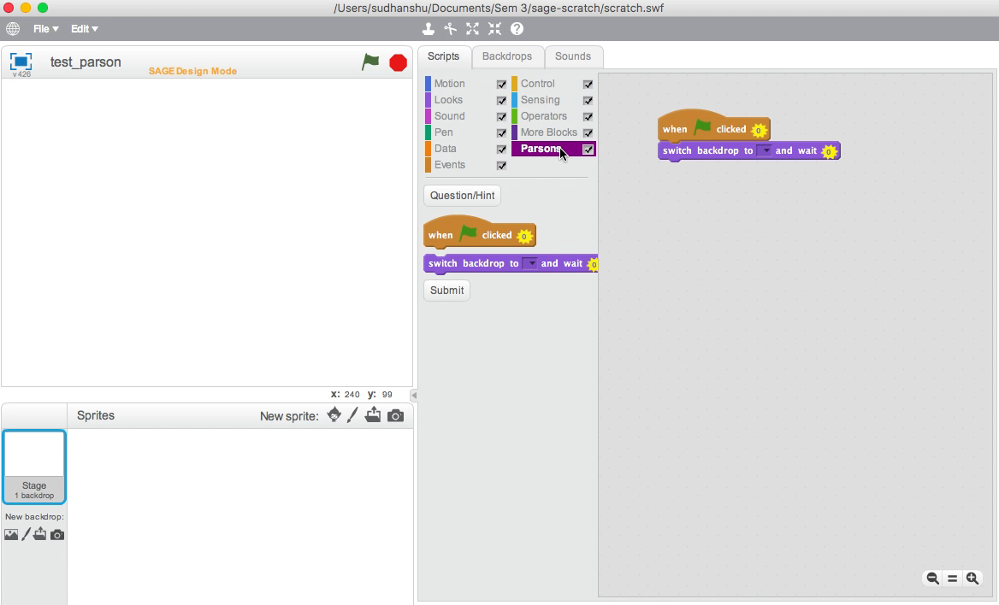
Sprint 2
Now - When a Parson's Puzzle is loaded in Design mode, the puzzle solution should appear in the script pane

Slide 11
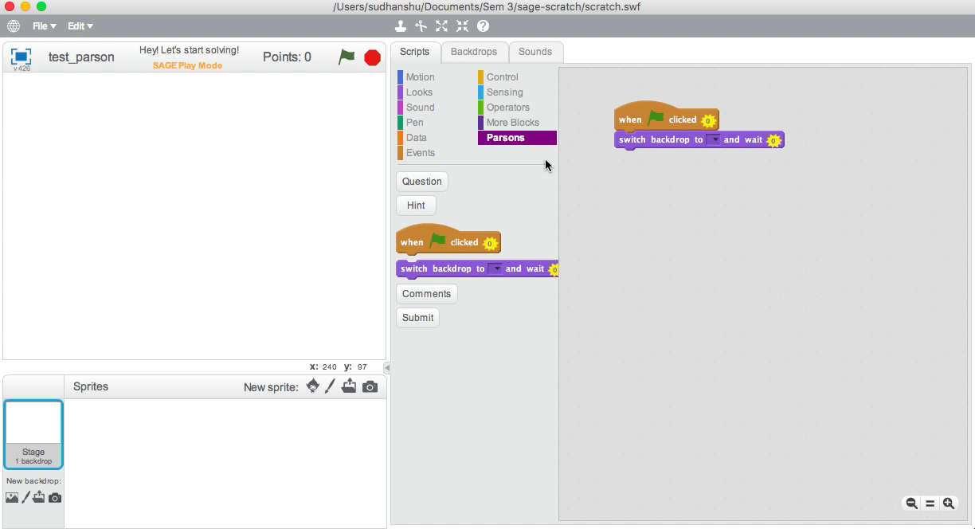
Sprint 2
Earlier

Slide 12
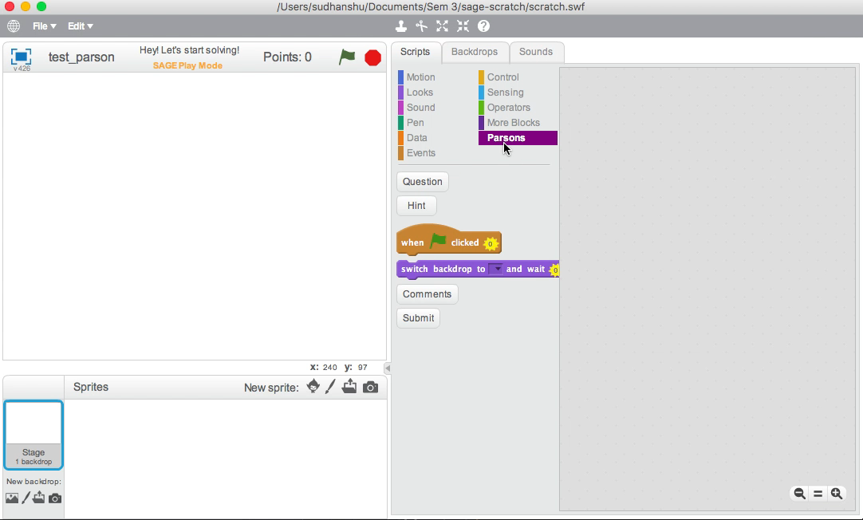
Sprint 2
Now - When a Parson's Puzzle is loaded in Play mode, the puzzle solution should not appear in the script pane.

Slide 13
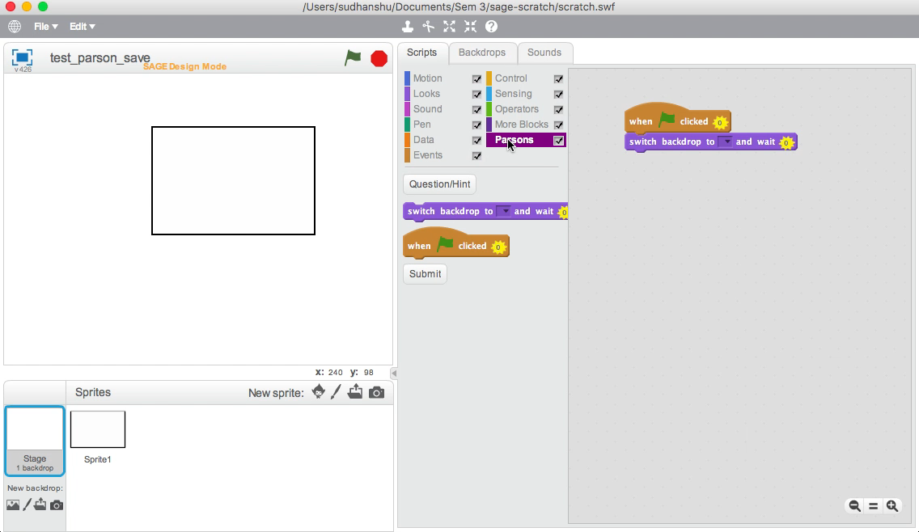
Sprint 2
Now - When a Parson's Puzzle is loaded in any mode, the stage content should display.

Slide 14
Thank You!

